Slide 1


SMart process analytics (Group 3) Final Presentation
Team Members
Aneesa Sultana Jagrasapalli, Nishikanth Palaka, Sudheer Kumar Ala & Md Ziauddin Ridoy

Slide 2

Structure
Introduction
Task Description
Implementation
Results.

Slide 3
Introduction

Slide 4
Predictor
N-gram model [1].
Simplicity [1].
Efficient approximate matching [1].

Slide 5
TASK Description

Slide 6
Predictor(N-grams)
Input: current instance, n value, log events
Filtering the data using the 'Lifecycle:transition' column
2. Iterating for 1 to n grams
Checking for any matches for the n gram in the log events.
Checking if there exists a next element for the matched sequence.
Appending the next element to a list.
3. Finding the probabilities of the next elements.
4. Displaying the next elements and the probabilities in a matrix format for 1 to n grams.
Output: next elements with their probabilities for 1 to n grams in a matrix format.

Slide 7
Implementation

Slide 8
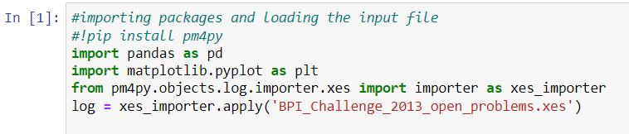
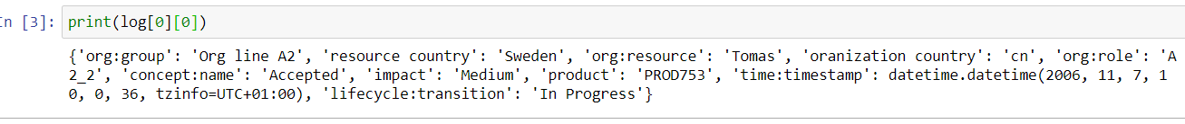
Importing the libraries for the xes file and further processing.
The log File

Slide 9
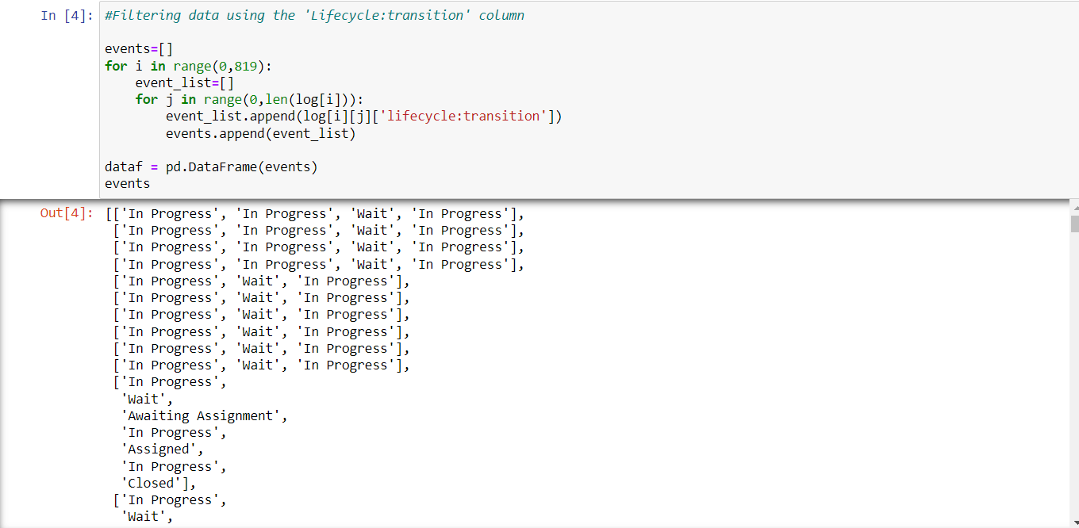
Filtering data using the 'Lifecycle:transition' column

Slide 10
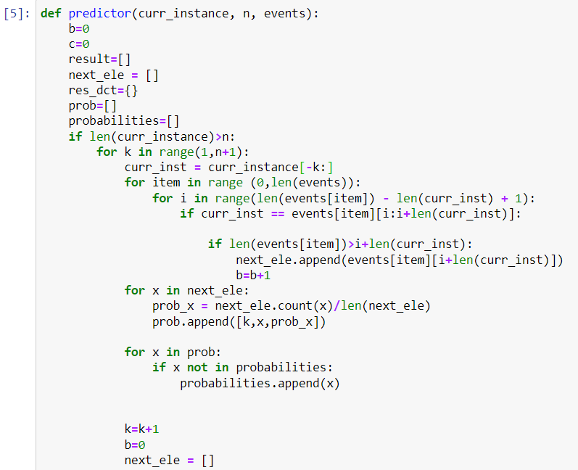
N-Grams Algorithm

Slide 11
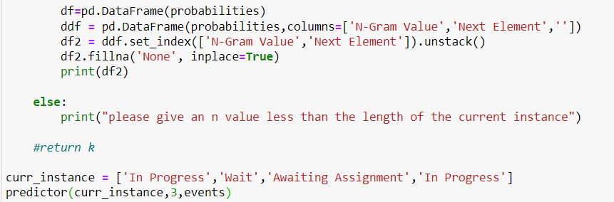

Slide 12
Results

Slide 13
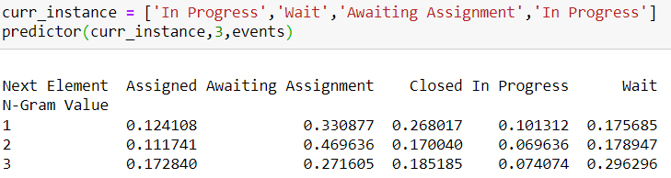
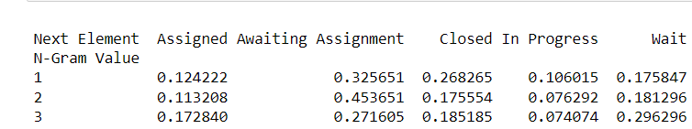
Results
Results with original event log
Results with process model mined in part 1

Slide 14
Thank you for your attention
Smart Process Analytics(21/22)
Aneesa Sultana Jagrasapalli, Nishikanth Palaka, Sudheer Kumar Ala & Md Ziauddin Ridoy

Slide 15
References
Speech and Language Processing. Daniel Jurafsky & James H. Martin. Copyright © 2021. All rights reserved. Draft of December 29, 2021.

